Slide 1
Dymola Model Validation Progress
Hari Naicker

Slide 2
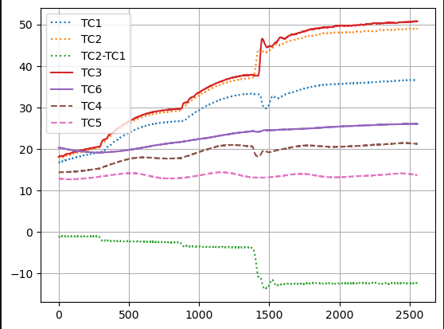
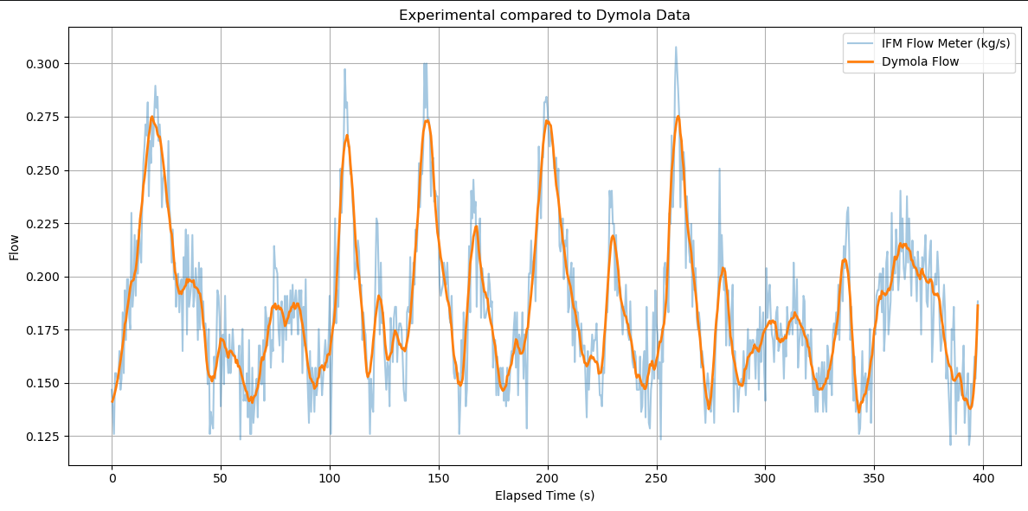
Data Processing
Data has been cleaned and uploaded to a processing script
TC6 may have issues when recording temperature values
  Does not correspond to TC3
Standard flow is accurate without heaters
  System responds to acute changes in pump speed after cleaning signal

Slide 3
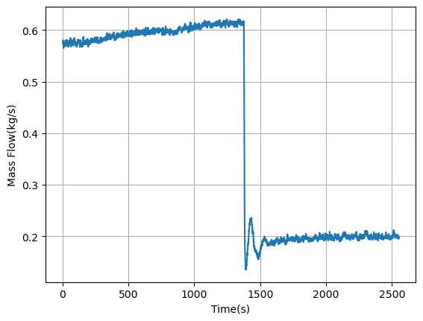
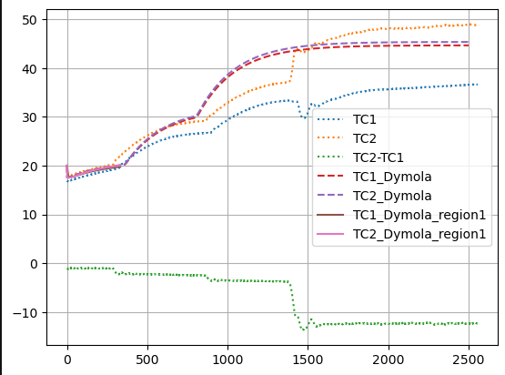
Heating Trials
Heat exchanger is taking some time to characterize
  Temperature difference is too low after heat transfer
Heaters seem to be inconsistent
Broke up simulation to troubleshoot per heater
Jet pump has been modified to geometries that are not physically accurate
Model slows down considerably when adding heaters

Slide 4
Current Troubleshooting
In future experiments:
  Better note keeping for when the system is adjusted
  Longer run time before turning on additional heaters
  Re-run heating trial without flow restriction to get uninterrupted data set
Make model stable for added heating
  Redefine initial conditions and figure out a smoothing threshold for the experimental data
  Identify good configuration for jet pump and heat exchanger through mass and heat transfer calculations

